Slide 1

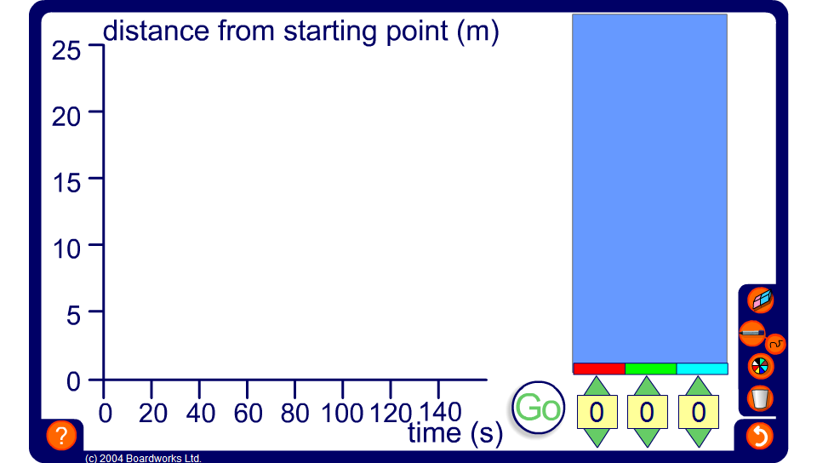


Olympic swimmers
Notes:
This animation shows a distance-time graph being plotted in real time. Start by choosing a different starting speed for each swimmer and pressing go.
Change the speed of the swimmers as the race progresses and note what happens on the graph. To make a swimmer stop altogether change his speed to 0.
You could ask one volunteer to vary the speeds of the swimmers and another to provide a race commentary, stating when one swimmer overtakes another, for example.

